Slide 1


Slide 2
INTRODUCTION
Ladies and gentlemen, welcome to our presentation on NVIDIA Corporation. In the next 14 pages, we will explore how NVIDIA has transformed the world of computing through its innovations. From its founding and key product lines to its profound impact on gaming, AI, autonomous vehicles, and high-performance computing, we'll provide a comprehensive view of NVIDIA's journey. Whether you're an investor, tech enthusiast, or simply curious about one of the most influential tech companies, this presentation will offer insights into NVIDIA's history, financial highlights, market position, and exciting future innovations. Let's begin our exploration of NVIDIA's remarkable contributions to the world of technology.

Slide 3
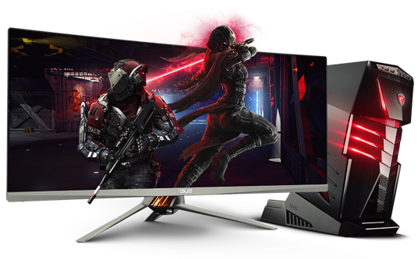
OVERVIEW OF NVIDIA
NVIDIA Corporation, based in Santa Clara, California, is a globally renowned technology company. Founded in 1993 by Jensen Huang, Chris Malachowsky, and Curtis Priem NVIDIA has become a key player in the tech industry. The company's primary mission is to "be the computing platform that powers the world's artificial intelligence (AI) and scientific breakthroughs." NVIDIA is synonymous with Graphics Processing Units (GPUs) and is widely recognized for its innovations in the GPU market, which extend beyond gaming to applications like AI, data centers, and autonomous vehicles.

Slide 4

FOUNDING AND EARLY HISTORY
NVIDIA's journey began with its three co-founders - Jensen Huang, who is still the CEO today, Chris Malachowsky, and Curtis Priem. The company's early focus was on producing high-performance GPUs for the gaming and computer graphics market. One of their first products was the NV1 graphics card, which laid the foundation for NVIDIA's subsequent success.

Slide 5
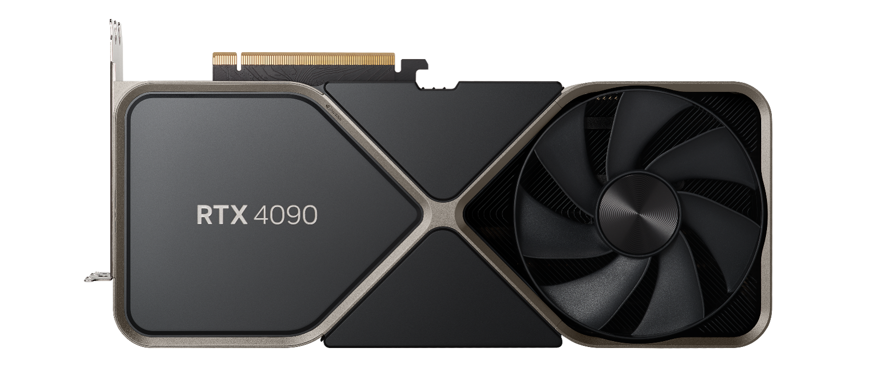
KEY PRODUCT LINES
Nvidia GPU RTX 4090
NVIDIA boasts a diverse portfolio of products. Its GPUs are the cornerstone, powering everything from gaming and professional graphics to AI and high-performance computing. The Tegra line of System on a Chip (SoC) products finds applications in mobile devices, Internet of Things (IoT) devices, and automotive systems. In data centers, NVIDIA's GPUs are essential for accelerating AI and scientific simulations. Finally, GeForce and Quadro GPUs cater to gaming enthusiasts and professional graphics users, respectivel

Slide 6
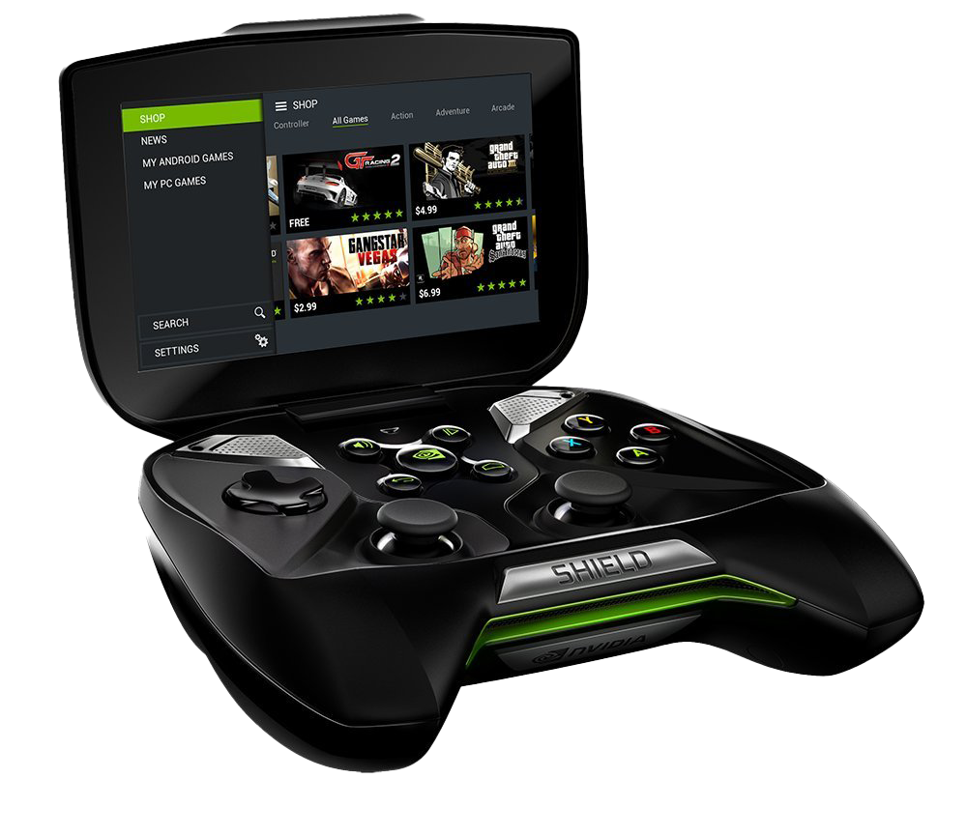
IMPACT ON GAMING
NVIDIA's impact on the gaming industry is immense. Over the years, they have consistently pushed the boundaries of graphics technology, enabling realistic and immersive gaming experiences. Their partnership with game developers has led to optimized games that take full advantage of NVIDIA GPUs. The GeForce brand has become synonymous with gaming excellence, while NVIDIA Shield offers game streaming capabilities and serves as a home entertainment hub. Additionally, NVIDIA has played a pivotal role in the burgeoning esports scene, providing powerful hardware for competitive gaming.

Slide 7

AI AND DEEP LEARNING
NVIDIA's GPUs have revolutionized the field of AI and deep learning due to their parallel processing capabilities. The company introduced CUDA, a parallel computing platform, which allows developers to harness the immense processing power of GPUs for a wide range of computational tasks. In addition, cuDNN is a GPU-accelerated library for deep neural networks that has become integral to the deep learning community. NVIDIA's GPUs are the preferred choice for AI practitioners and researchers, and popular deep learning frameworks like TensorFlow and PyTorch offer seamless support for NVIDIA GPUs, making them a go-to solution for AI development.

Slide 8
AUTOMOTIVE TECHNOLOGIES
1
2
Ensuring safety and regulatory compliance is a paramount concern in the development of autonomous driving technology, and NVIDIA actively addresses these challenges.
The company collaborates with major automakers like Tesla, Audi, and Mercedes-Benz to provide AI-powered self-driving systems.
3
4
NVIDIA is at the forefront of autonomous driving technology, developing advanced solutions under its DRIVE platform.
These systems incorporate AI algorithms for perception, decision-making, and control, making them an essential component of the autonomous vehicle revolution.

Slide 9
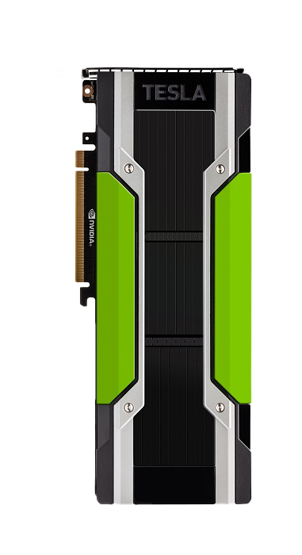
NVIDIA GPUs play a critical role in accelerating high-performance computing (HPC) and AI workloads in data centers. The company's data center solutions include GPUs designed specifically for these tasks, such as the Tesla series. NVIDIA DGX systems, purpose-built for AI and deep learning, have gained widespread adoption in various industries. Moreover, NVIDIA CUDA supercomputers, like Summit and Sierra, are instrumental in scientific research, simulations, and discoveries. These powerful computing systems have accelerated research in fields ranging from climate modeling to drug discovery.
DATA CENTERS
AND HPC
Tesla P100

Slide 10
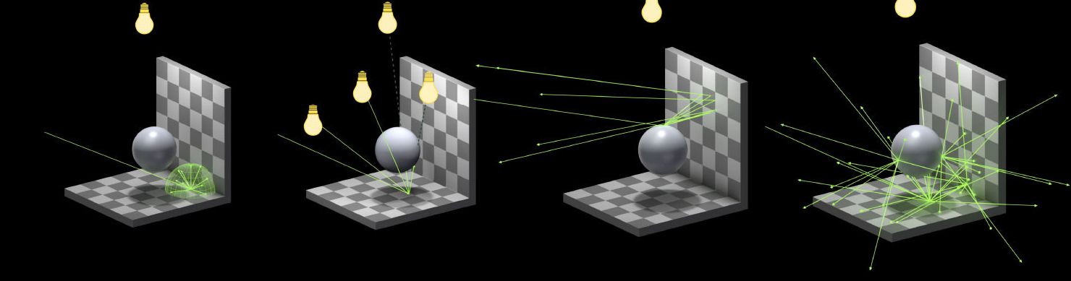
RAY TRACING AND GRAPHICS
NVIDIA's introduction of real-time ray tracing technology has transformed the gaming and graphics industry. Real-time ray tracing enables lifelike graphics, rendering lighting, shadows, and reflections in a way that was previously only achievable in cinematic
pre-rendered sequences. NVIDIA's RTX GPUs, featuring hardware support for ray tracing, have set a new standard in visual fidelity in video games and applications. This innovation has fundamentally changed the way we perceive and interact with virtual worlds, enhancing the realism and immersion of gaming and graphics applications.

Slide 11

FUTURE INNOVATIONS
NVIDIA continues to drive innovation across various fronts. The company's roadmap is forward-looking, with a focus on advancements in AI, quantum computing, and sustainability. Initiatives like NVIDIA Grace are aimed at bringing AI and HPC closer together, enabling breakthroughs in scientific research and discovery. NVIDIA also invests heavily in AI research, quantum computing, and sustainability initiatives, recognizing the importance of technology in addressing critical global challenges, such as climate change.

Slide 12
FINANCIAL
HIGHLIGHTS
NVIDIA has experienced remarkable revenue growth over the years, primarily driven by GPU sales, data center expansion, and strong adoption of AI technologies. Key financial metrics include impressive revenue figures, healthy profit margins, and significant investments in research and development to fuel ongoing innovation.
NVIDIA gross profit for the twelve months ending July 31, 2023 was
$21.120B

Slide 13
MARKET
POSITION
NVIDIA holds a dominant position in the GPU market, with a substantial market share. While AMD is a formidable competitor in the GPU space, NVIDIA's presence extends beyond graphics to data centers, AI, and automotive technologies. NVIDIA has established a global presence through strategic partnerships and collaborations with industry leaders, solidifying its position as a technology pioneer.

Slide 14










CONCLUSION
In conclusion, NVIDIA's impact on the technology landscape is undeniable. From revolutionizing gaming and enabling AI breakthroughs to powering autonomous vehicles and advancing scientific research, the company's innovations have left an indelible mark. As we look to the future, NVIDIA's commitment to pushing the boundaries of technology and addressing global challenges makes it an exciting entity to watch and consider for investment opportunities.

Slide 15
THANK YOU

Slide 16
Instructions for use
You must credit Slidechef in order to use this template
What you are allowed to do :
Modify this template
Use it for personal or commercial projects
What you are not allowed to do :
Offer Slidechef templates for download
Sublicense, sell or rent any Slidechef content
Distribute Slidechef content unless it has been authorized
Include Slidechef content in an online or offline file
Acquire the copyright of Slidechef content

Slide 17

Slide Chef

